Slide 1
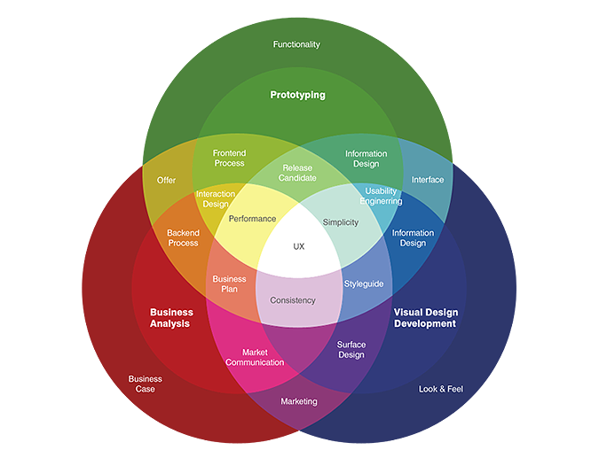
Human-Centric Quality & UX Engineering
Connecting Quality,
Technology, and Human Needs.

Slide 2
Understanding HCQ & UX Engineering
Human-Centric Quality & UX Engineering is an approach that focuses on creating software that is reliable, usable, accessible, and satisfying for people.
Traditional software quality is not enough because a bug-free system can still be difficult, confusing, or frustrating for users.
This approach represents a shift from system-focused to human-focused engineering, where the goal is not only to improve system performance but also to design solutions based on user needs, behaviors, and experiences.

Slide 3
Why UX & QA Need Each Other
UX and Quality Assurance (QA) are closely connected because both focus on creating better software experiences for users.
UX ensures that a product is intuitive, accessible, and easy to use, while QA ensures that it works correctly, reliably, and consistently.
By combining UX principles with QA practices, teams can identify usability issues, prevent user frustrations, and validate that the product meets both functional requirements and user expectations.
This collaboration helps deliver software that is not only technically high-quality but also meaningful and enjoyable for users.

Slide 4
Key Pillars of Human-Centric Quality & UX Engineering
The core principles of Human-Centric Quality & UX Engineering focus on designing software around the needs and experiences of users.
User-centered design ensures that products are built based on real user goals and behaviors.
Accessibility and inclusion make sure that everyone, including people with different abilities, can use the product effectively.
Simplicity and clarity help users understand and complete tasks easily, while error prevention and recovery reduce mistakes and provide ways to recover when problems occur.
Finally, continuous improvement through feedback ensures that products evolve based on user insights and changing needs.

Slide 5
How QA Measures UX
Quality Engineering in UX ensures that digital products provide a smooth, reliable, and user-friendly experience.
Usability testing evaluates how easily users can understand and complete tasks, while accessibility testing ensures the product can be used by people with different abilities.
Performance testing checks speed, responsiveness, and stability, and user journey testing validates the complete experience across different interactions.
Real-world scenario testing focuses on how the product performs in practical situations, helping teams identify issues that may affect user satisfaction and overall experience.

Slide 6
Real-World Application
Human-Centric Quality & UX Engineering can be seen in many real-world applications. In banking apps, it ensures secure, simple, and accessible experiences for tasks such as payments and account management.
In healthcare systems, it helps create reliable and easy-to-use platforms that support patients and healthcare professionals.
E-commerce platforms use these principles to provide smooth navigation, personalized experiences, and efficient purchasing processes.
Mobile applications apply human-centric approaches to deliver responsive, intuitive, and user-friendly experiences that meet the needs of diverse users.

Slide 7
Challenges & Future
Human-Centric Quality & UX Engineering faces several challenges, including balancing business objectives with user needs, accurately measuring user experience, and integrating UX practices throughout the software development process.
However, future trends such as AI-powered personalization, inclusive design, voice and conversational interfaces, and human-centered AI systems are creating new opportunities to improve digital experiences.
Ultimately, a successful product is not only functional and reliable but also easy to use, accessible, and meaningful for the people who interact with it.

Slide 8
Conclusion

